Slide 1

EXCEL ANALYTICS PROJECT
Personal Finance
Dashboard
Track income, expenses, savings & budget in one place
Presented by
Soumodip Mondal
Microsoft Excel | FY 2026 | 441 Transactions
Interactive financial dashbard
PERSONAL FINANCE DASHBOARD | EXCEL PROJECT
1 / 6

Slide 2
Business Problem & Project Objective
Why the dashboard was needed
THE SITUATION
PROJECT OBJECTIVE
• The source data contained individual financial transactions.
• It was difficult to see the overall financial position from raw rows.
• Monthly income and expense trends required manual analysis.
• Spending categories, accounts and payment methods were not immediately visible.
• Budget performance and savings needed a consolidated view.
Transform raw transaction data into an interactive Excel dashboard that makes financial performance easy to monitor and explain.
• How much income and expense?
• How much was saved?
• How is the budget being utilized?
• Which categories and accounts drive transactions?
PERSONAL FINANCE DASHBOARD | EXCEL PROJECT
2 / 6

Slide 3
Data & Analysis Requirements
Building the analysis around measurable financial KPIs
TRANSACTIONS
INCOME TXNS
EXPENSE TXNS
YEAR
TOOL
441
99
342
2026
Excel
KEY DATA FIELDS
ANALYSIS REQUIREMENTS
• Date, Transaction Type and Amount
• Category and Sub-Category
• Account, Bank and Payment Method
• Budget, Savings Goal and Balance
• Month and Quarter for trend analysis
• Total Income & Total Expenses
• Net Savings & Savings Rate
• Budget Utilization & Current Balance
• Monthly trends and category analysis
• Account, bank and payment-method analysis
PERSONAL FINANCE DASHBOARD | EXCEL PROJECT
3 / 6

Slide 4
Excel Methodology
From raw transactions to an interactive dashboard
01
02
03
04
05
06
Prepare
Calculate
Summarize
Visualize
Interact
Design
Organize & validate the dataset
Build financial KPIs with formulas
Create PivotTables
Create charts and comparisons
Add Month & Account slicers
Assemble the final dashboard
KEY FORMULAS
Net Savings = Income − Expenses
Savings Rate = Net Savings ÷ Income
Budget Utilization = Expenses ÷ Budget
Current Balance = Latest recorded balance
Image to use: Excel KPI calculation sheet
PERSONAL FINANCE DASHBOARD | EXCEL PROJECT
4 / 6

Slide 5
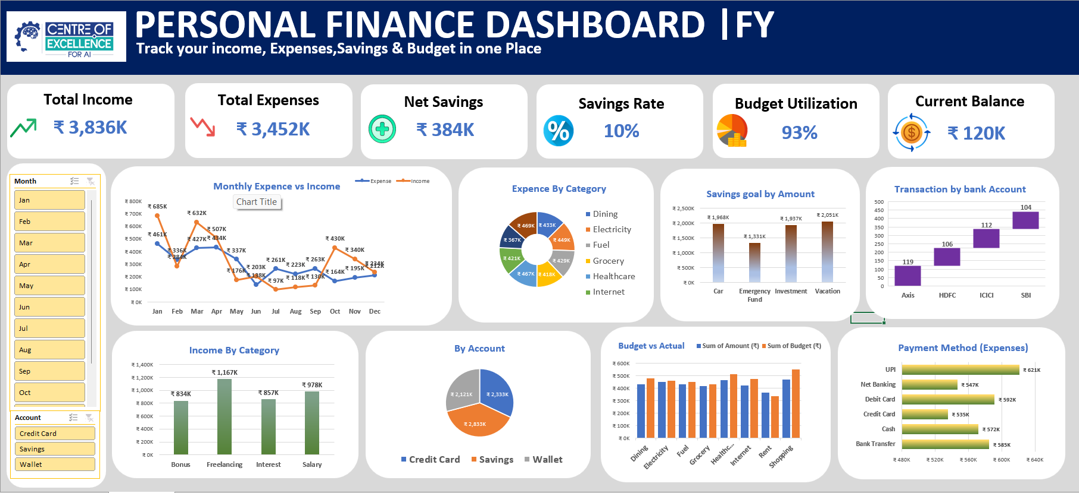
04 | DASHBOARD
Final Dashboard
One-page view of income, expenses, savings and spending patterns
Use this full dashboard screenshot as the main presentation image
PERSONAL FINANCE DASHBOARD | EXCEL PROJECT
5 / 6

Slide 6
05 | RESULT
Results, Insights & Learning
TOTAL INCOME
TOTAL EXPENSES
NET SAVINGS
SAVINGS RATE
BUDGET
₹ 3.836M
₹ 3.452M
₹ 383.9K
10%
93%
RESULT
LEARNING OUTCOME
• Converted 441 raw transactions into a structured analytical dashboard.
• Created KPI-driven financial monitoring.
• Enabled monthly and account-level filtering.
• Combined numerical analysis with visual storytelling.
• Excel formulas and financial calculations
• PivotTables and PivotCharts
• Slicers and interactive reporting
• Dashboard design and data storytelling
PERSONAL FINANCE DASHBOARD | EXCEL PROJECT
6 / 6

